Slide 1

Stages
Better Processes in Practice

Slide 2
Stages – Better Processes in Practice
Stages
is a Business Process Management Suite optimized for knowledge-intensive business processes
(e.g. product development, systems/software/IT projects, organizational process frameworks and operating models)
lets people easily understand and perform processes
integrates with existing tools and repositories to
automate processes
assures process compliance to governance frameworks like ISO, CMMI, ITIL, COBIT and many more
is web based and cloud ready
is proven in large scale global deployments

Slide 3


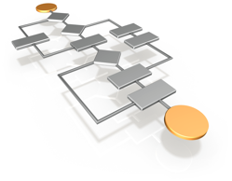
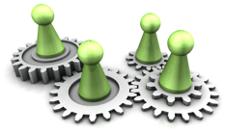


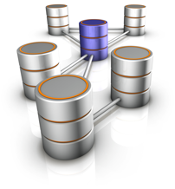
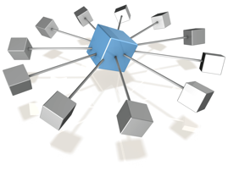

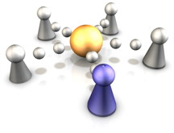

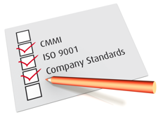
Stages Functions
Use
Share
^{Process}
^{Tailoring}
^{Work Product Management}
Define
^{Process}
^{Visualisation}
^{Dynamic Views}
^{Process}
^{Execution}
^{Metrics & Evidences}
^{Flexible Notation}
^{Collaborative}
^{Modeling}
^{Collaboration & Feedback}
^{Release &}
^{Versioning}
Full Process Landscape
^{Compliance}
^{Management}

Slide 4
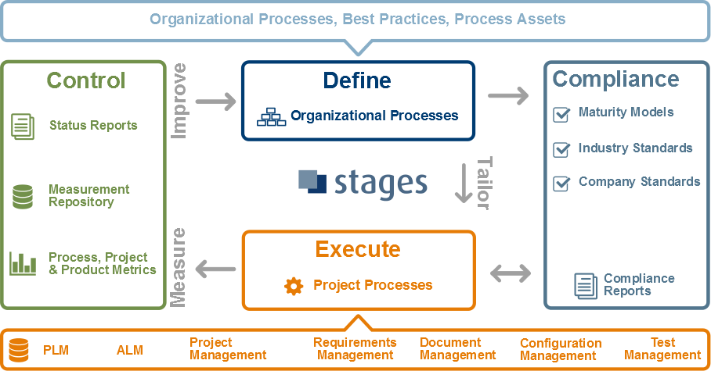
Stages Concept

Slide 5
Sample Use Cases
Enable Governance, Transparency and Compliance
Establish User-Centric Processes
Provide Quality Gate Process Execution
Provide Integrated Process Automation

Slide 6
Governance,Transparency and Compliance
What usually happens:
Organizations publish policy, procedure and regulation documents
People find it very difficult to find the documents and use them in their daily work
Why Stages is different:
Stages contains all kinds of process content and automatically manages and maintains links between the different parts and layers
Compliance to CMMI, Automotive SPICE, ISO 26262, ISO 62304, DO-178/254, ITIL, COBIT, etc. is managed in the background
Your benefits:
People have a unique transparent source for all process content
Reduced efforts for demonstrating and assuring compliance

Slide 7
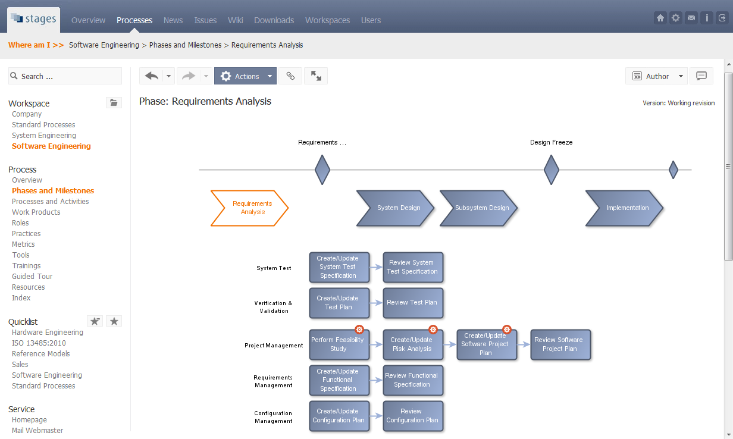
Use Case: Process Governance
Application Lifecycle Process
Application Lifecycle Process
Process Details

Slide 8
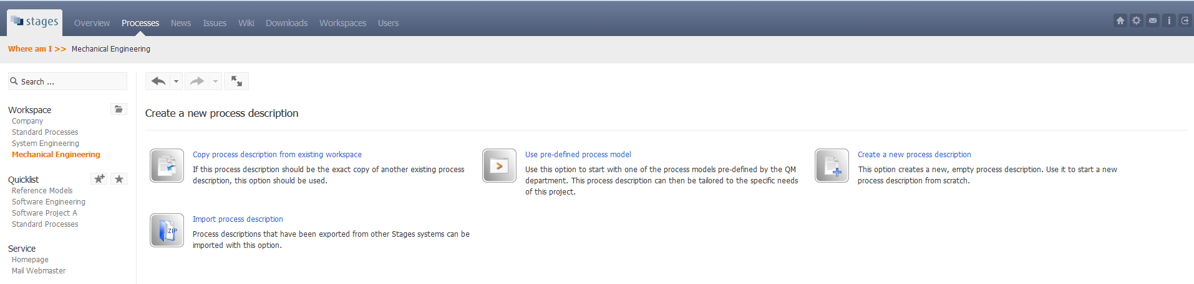
Use Case: Process Governance
Import of existing process descriptions of various formats
Reuse of existing processes and process models

Slide 9
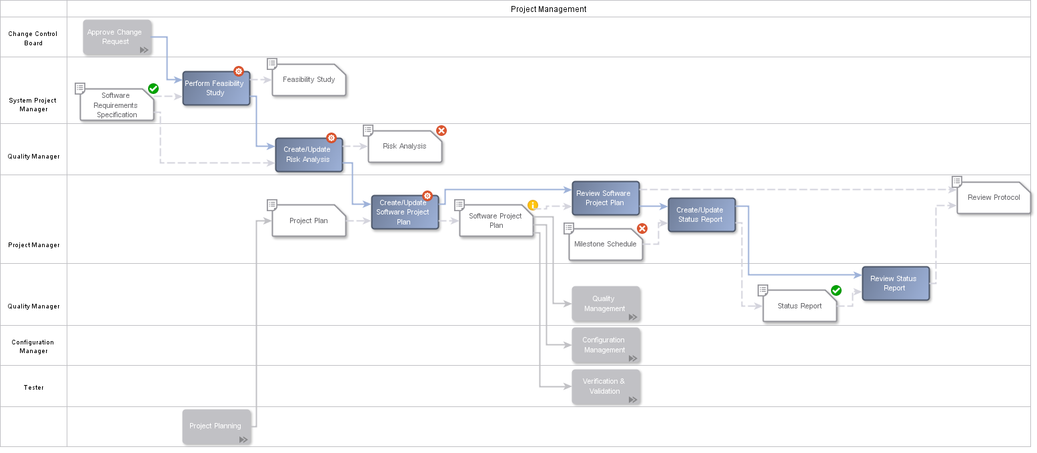
Use Case: Process Transparency
What
should
be done
Who is
responsible
What can be used and
what should be created
Automatic process visualization, e.g. using swimlane diagrams

Slide 10
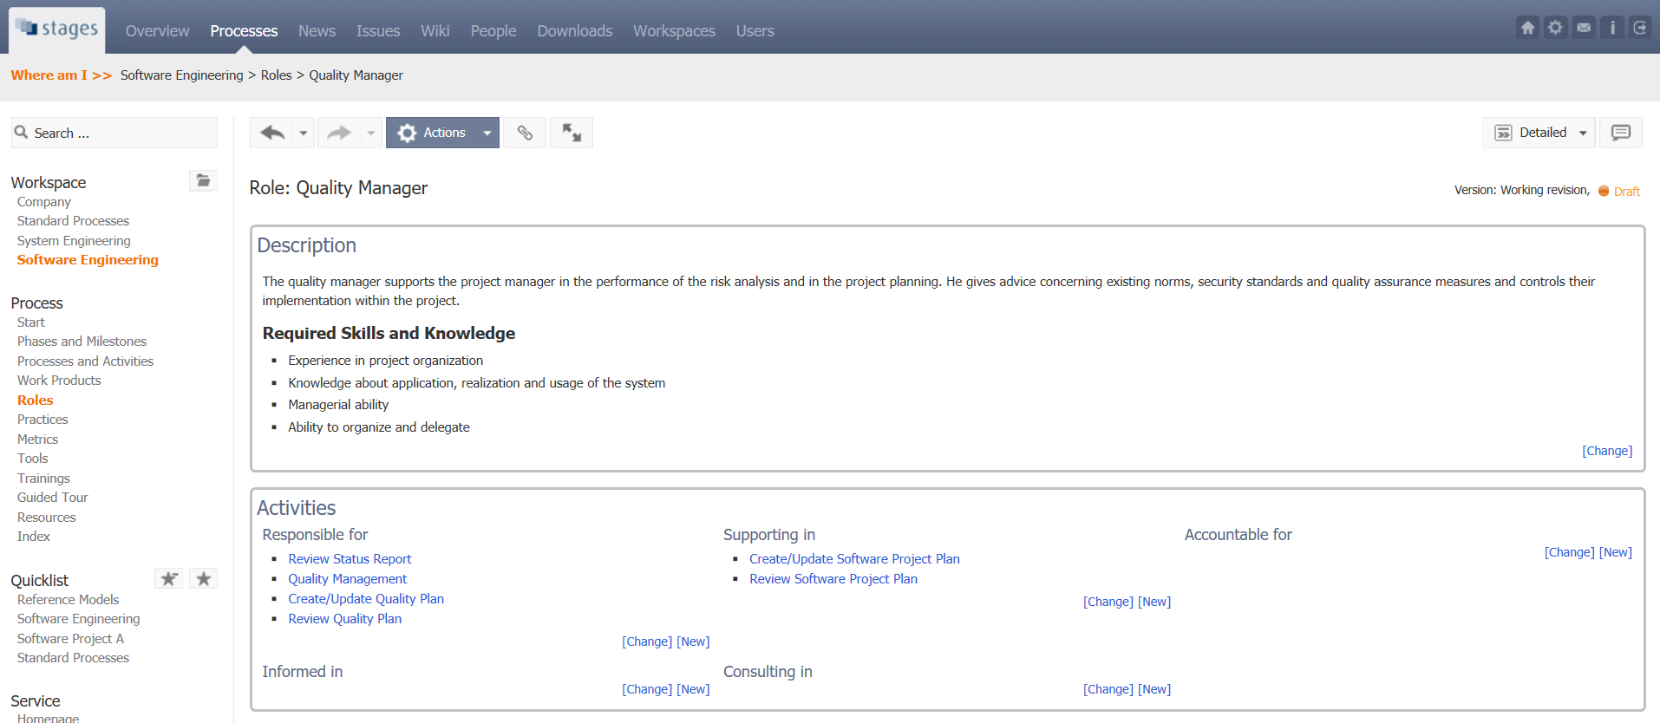
Use Case: Transparency
Clear overview over all important activities of a role

Slide 11
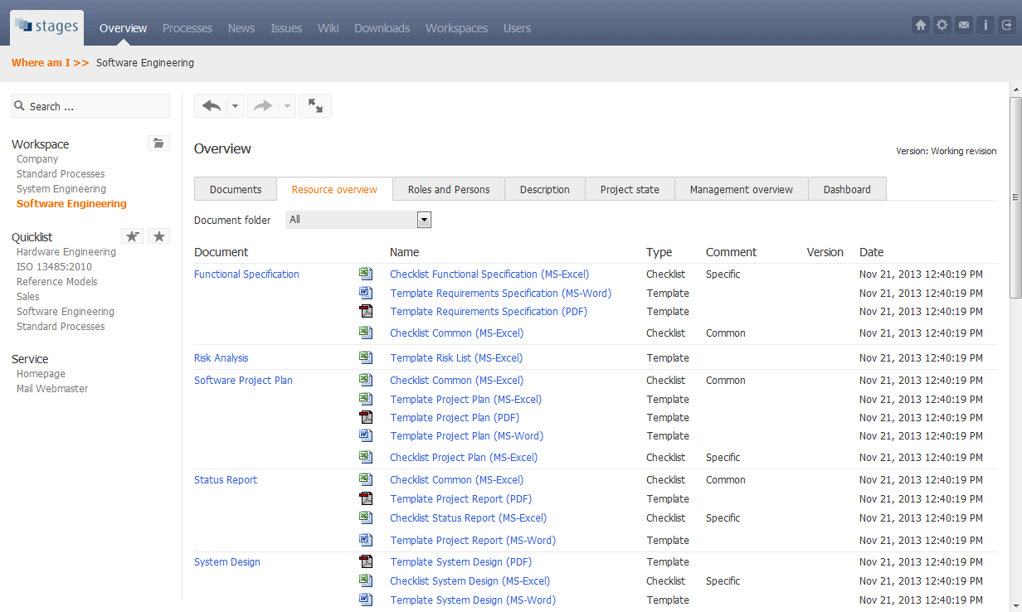
Use Case: Collection of
Entire Process Information
Overview of all templates, examples, checklists etc.

Slide 12
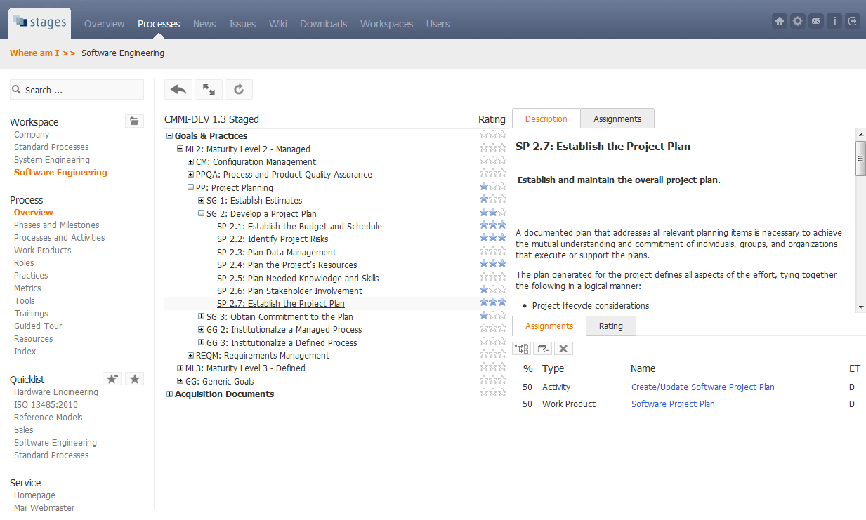
Use Case: Assure Compliance to Frameworks
1) Map standard requirements...
2) ...to defined
process…
3) ...and
identify
gaps.

Slide 13
Sample Use Cases
Enable Governance , Transparency and Compliance
Establish User-Centric Processes
Provide Quality Gate Process Execution
Provide Integrated Process Automation

Slide 14
User-Centric Processes
What usually happens:
Organizations publish abstract standard process descriptions and process graphics in Visio or PowerPoint
People either follow only parts of the process or ignore it at all
Why Stages is different:
Process descriptions and process visualizations are tailored to be project specific
Process is user-centric and lean, only the context relevant to a user or role and for the specific project is shown
Your benefits:
People easily understand the process and what they need to do in a specific situation
Better process acceptance and fidelity

Slide 15
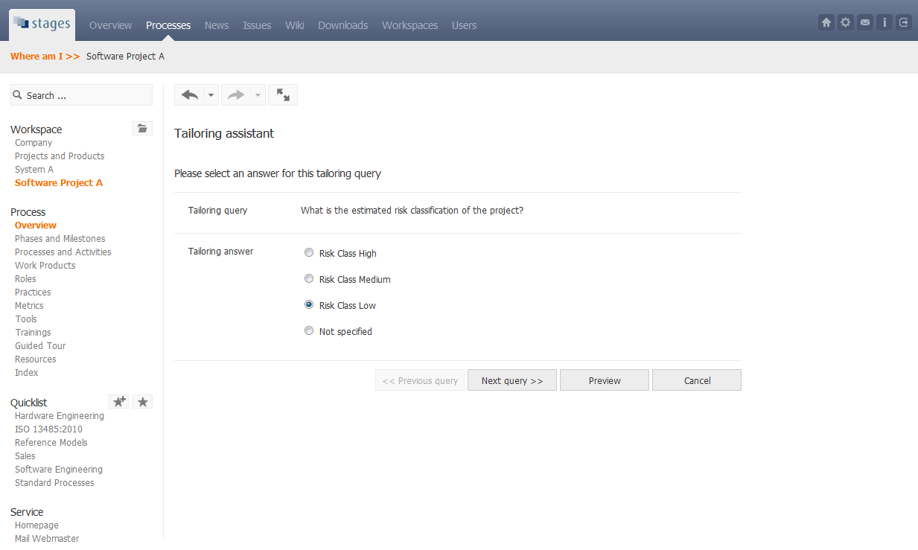
User-Centric Processes: Tailoring
Process
Tailoring

Slide 16
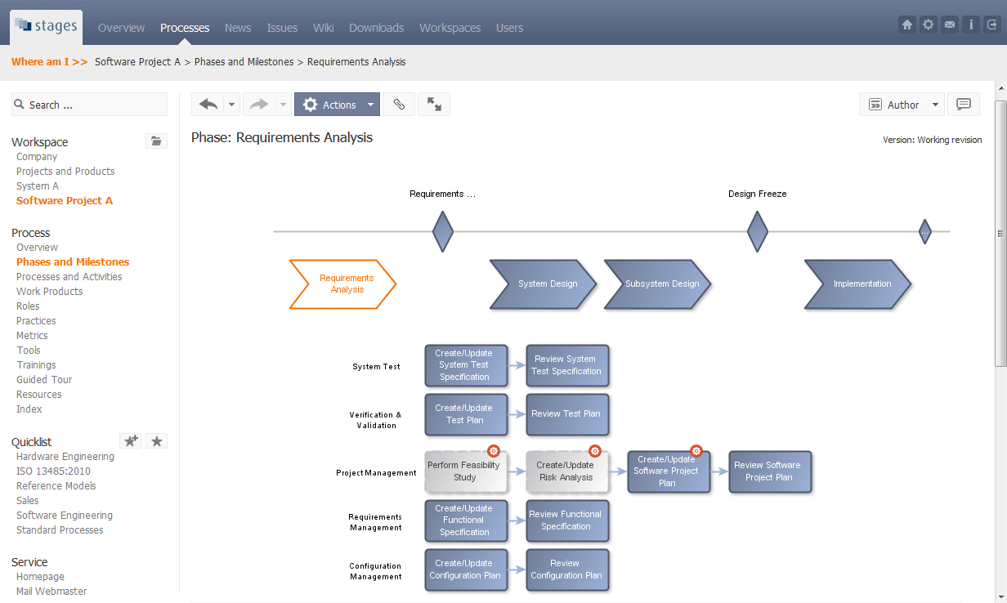
User-Centric Processes: Tailored
Standard Process
Standard Process
Tailored to the project`s needs

Slide 17
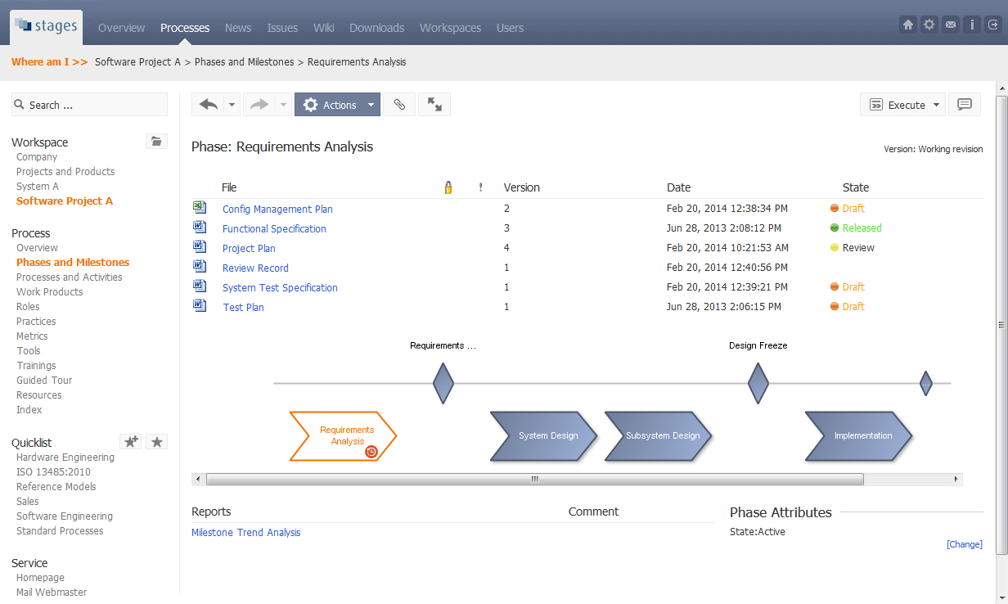
User-Centric Processes: Lean
Process and Status
Simplified User-Centric Process
Status of document
in repository
Direct access of
project reports
Current project phase

Slide 18
Sample Use Cases
Enable Governance , Transparency and Compliance
Establish User-Centric Processes
Provide Quality Gate Process Execution
Provide Integrated Process Automation

Slide 19
Quality Gates
What usually happens:
Organizations define abstract static project lifecycle with milestones and quality gates
Documents required for quality gates are manually collected from different repositories, checked and approved
Why Stages is different:
Milestones, quality gates and required documents are defined in the project-specific process description
Required project documents and their status are automatically shown, regardless where they are stored
Your benefits:
Consistent and efficient document check and approval
Harmonized access across different tools, platforms and repositories

Slide 20
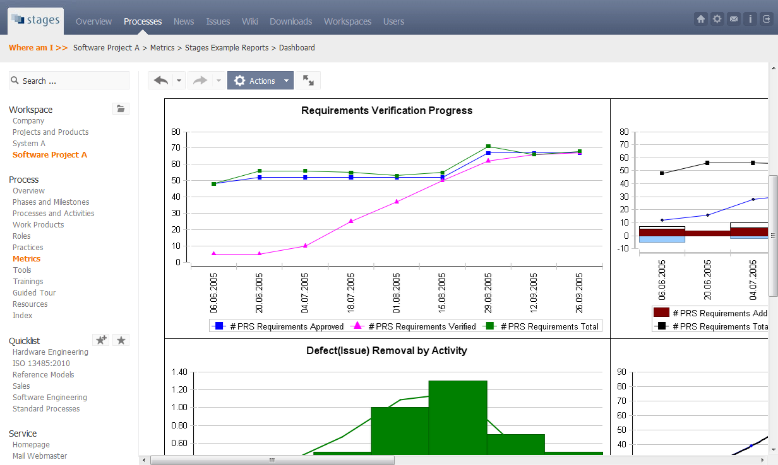
Quality Gates:
Sample Project Status Report
Project dashboard extracted from various data sources

Slide 21
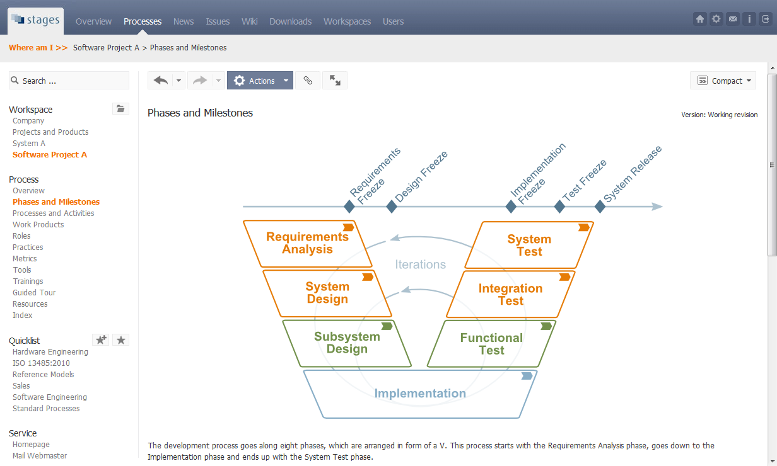
Quality Gates: Definition in Lifecycle
Quality Gates
Quality Gates

Slide 22
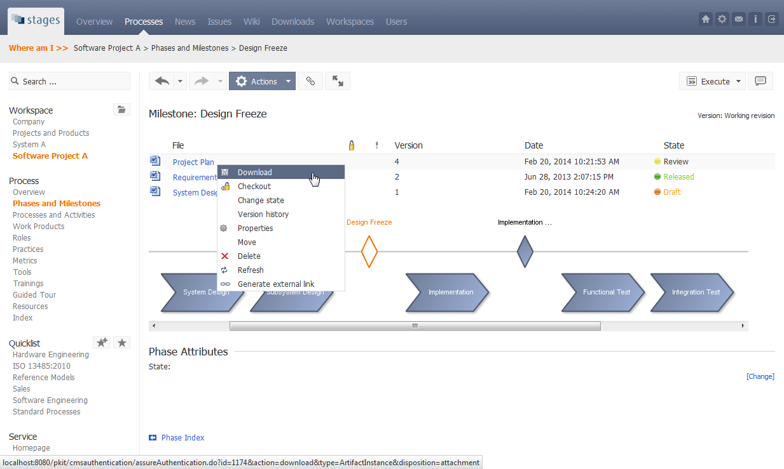
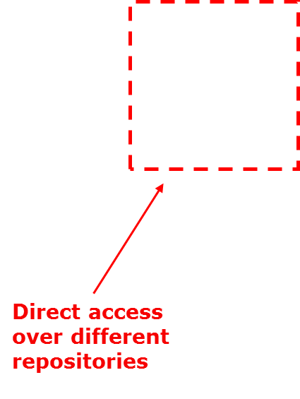
Quality Gates: Documents, Status
Viewand Direct Document Access
Required Documents for a Quality Gate
Unified view across different repositories

Slide 23
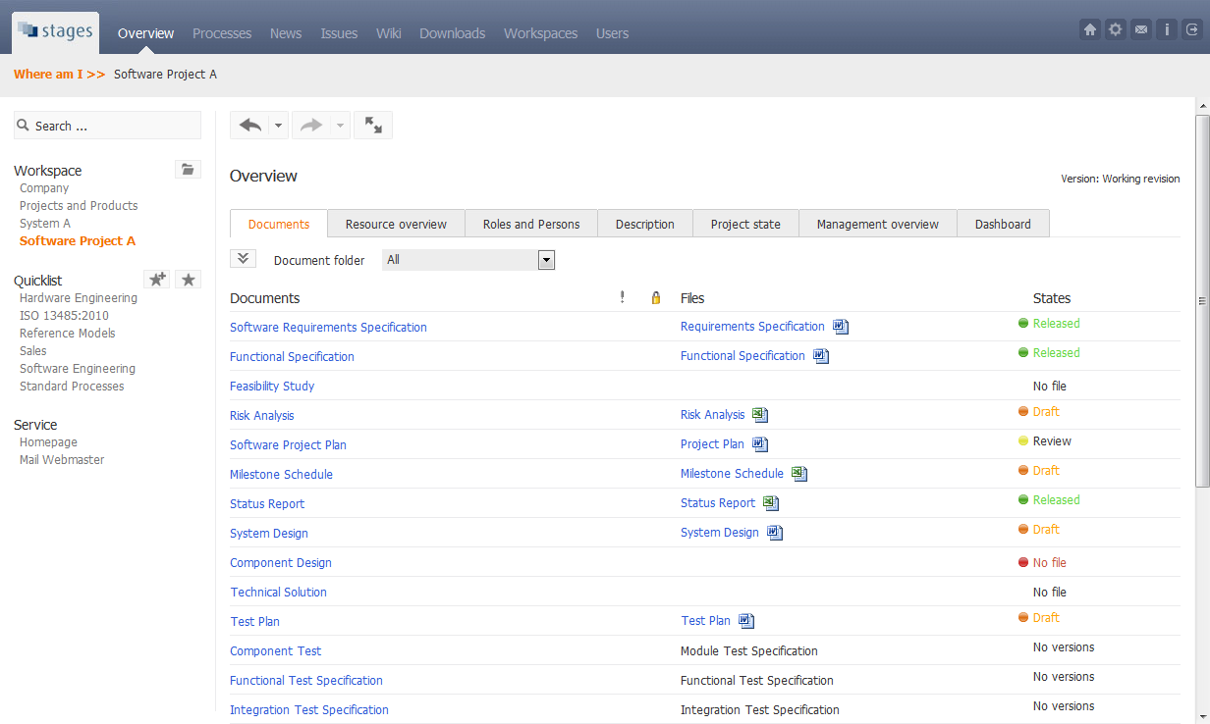
Quality Gates: Unified Document and Status View
Unified view across different repositories
Project Documents

Slide 24
Sample Use Cases
Enable Governance , Transparency and Compliance
Establish User-Centric Processes
Provide Quality Gate Process Execution
Provide Integrated Process Automation

Slide 25
Integrated Process Automation
What usually happens:
Processes are rigidly defined in Visio or Powerpoint and manually configured or programmed into the execution tools
Process changes cause substantial efforts and have long cycle times
Why Stages is different:
Processes can be holistically defined and deployed to execution tools
People can work in their usual environment, the process supports their daily work in the background
Your benefits:
Consistent implementation of processes across all execution tools
Instant and efficient propagation of process changes

Slide 26
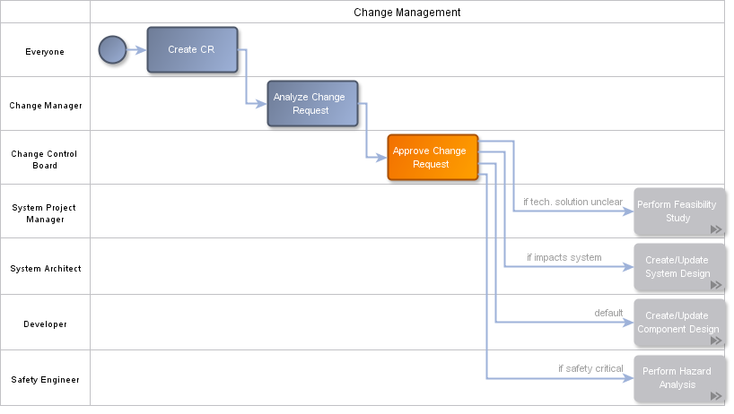
Integrated Process Automation:
Process Definition
Processes to be automated can be defined within the
unified organizational process framework
Modified and tailored processes can easily be deployed to the process execution tools

Slide 27
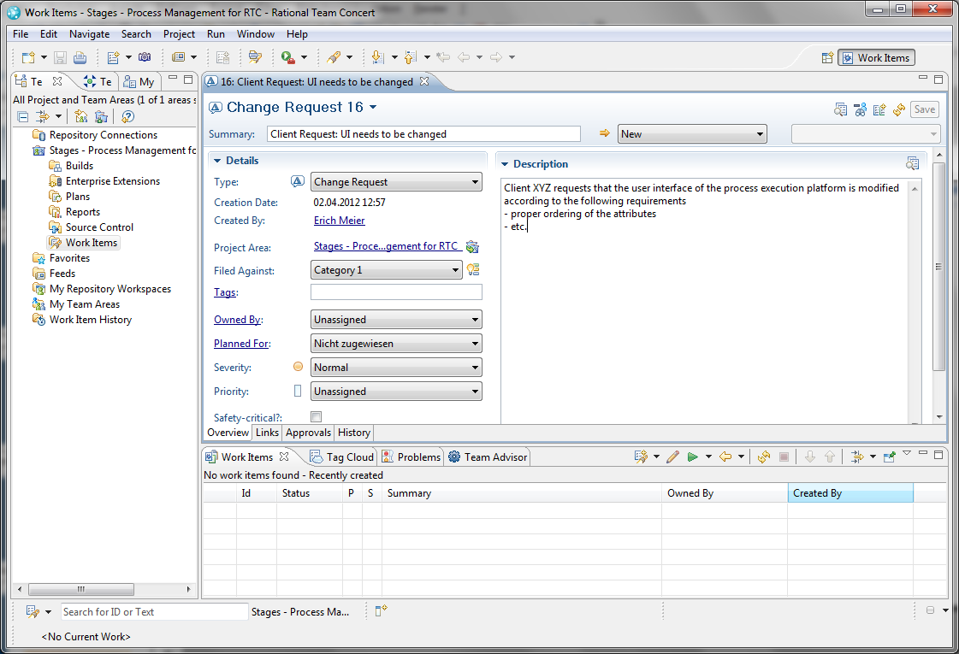
Integrated Process Automation:
User Environment
User creates Change Request in the usual user environment
Sample Environment: IBM Rational Team Concert

Slide 28
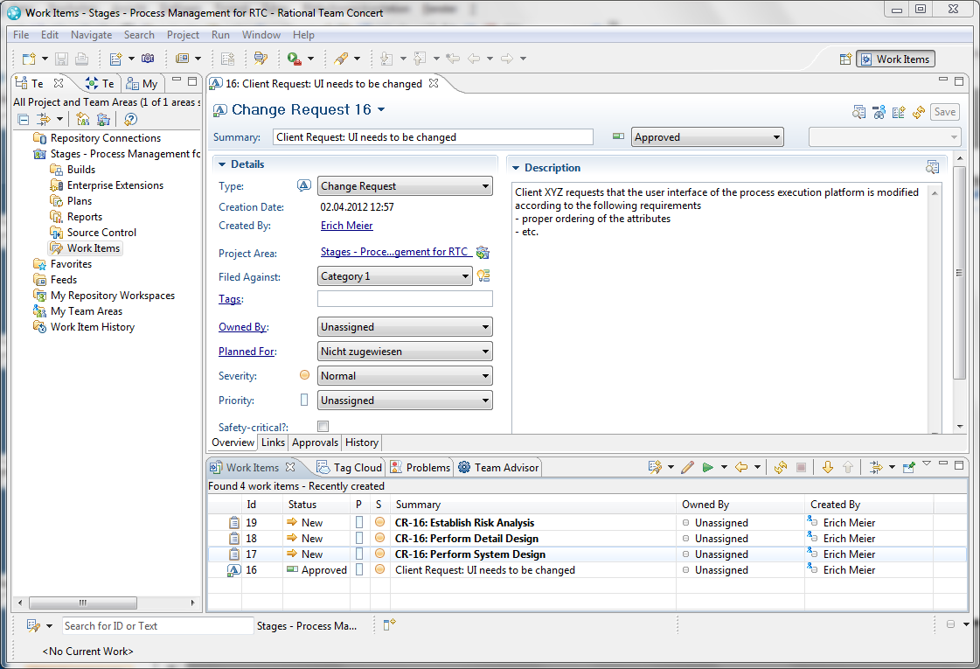
Integrated Process Automation:
Active Process
Work tickets are automatically created according to the defined process in this project
Sample Environment: IBM Rational Team Concert

Slide 29
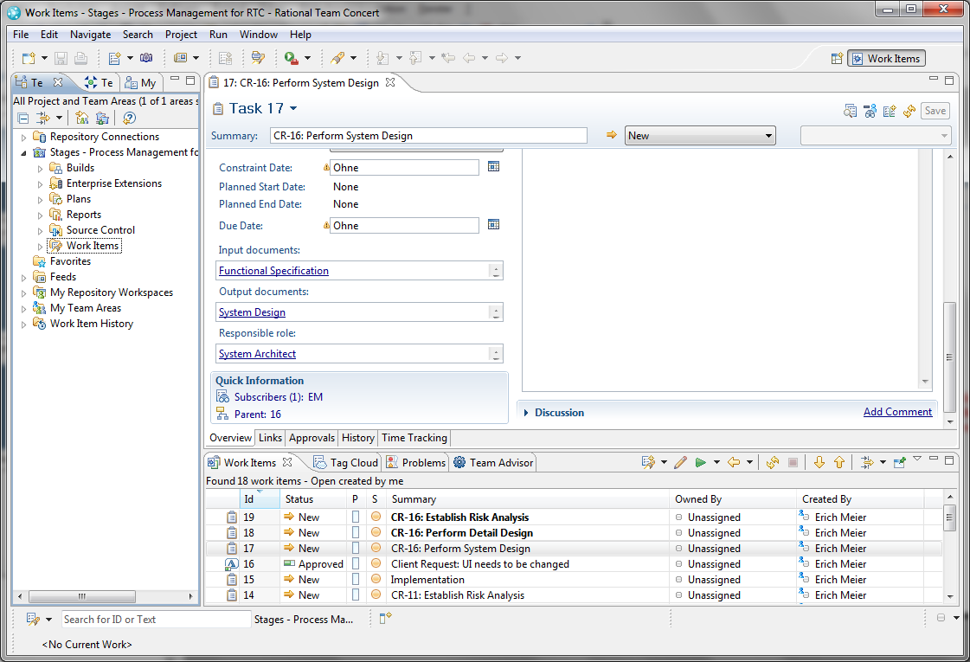
Integrated Process Automation:
Direct Access
Process related data is automatically transferred
Sample Environment: IBM Rational Team Concert

Slide 30
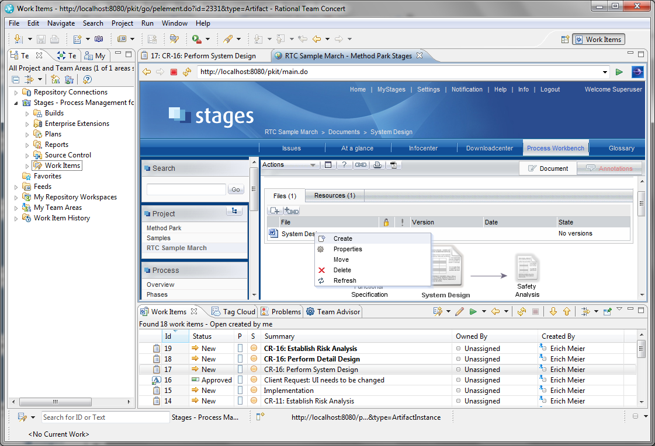
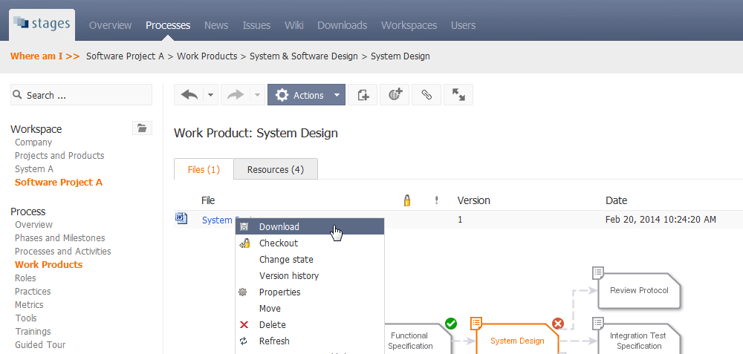
Integrated Process Automation:
Direct Access
Direct
access
to related
data
Sample Environment: IBM Rational Team Concert

Slide 31
Interfaces
Application Lifecycle Management (ALM) Systems
  PTC Integrity, IBM Rational Team Concert (Jazz), JIRA
Configuration Management Systems
  IBM ClearCase, Serena Version Manager (PVCS), MKS Source Integrity,
  Serena Dimensions, IBM Telelogic Synergy, CVS, Subversion
Project Management Systems
  MS Project, Primavera, ACTANO RPlan
Document Management and Office Suites
  MS Sharepoint, MS Word, MS Excel, MS Powerpoint, PDF
Process Modeling and Process Improvement
  MS Visio, ARIS, EPF, IBM Rational Method Composer, Appraisal Wizard
All trademarks are the property of their respective owners

Slide 32
Our Stages Customers
Automotive
  Audi Electronics Venture, Audi, BMW, Brose, Bosch Engineering, Bosch (multiple divisions), CARMEQ, Continental, Delphi, ebm papst, ESG, ETAS, General Motors, Harman, Haberl Electronics, Helbako, Hella, HiRain Technologies, IAV, Infineon, Johnson Controls, Knorr Bremse, Kostal, KSPG, Mando, Magna Electronics, Marquardt, Panasonic, Peiker Acustic, Preh, SK Continental, TRW, Volkswagen, ZF (multiple divisions)
Medical / Healthcare / Rail
  Bosch Innovations, NewTec, Siemens Healthcare, Siemens Mobility,
  Thales Rail, TomTec
Defense / Aerospace / Space
  Elbit Systems, JAXA, Orbital Sciences, Raytheon, Rockwell Collins, Ruag Space, Sandia
Banking / IT
  Atos Origin, DHL/German Mail, Fidelity Information Services Kordoba, GMC, Intersoft
  Further
  Bosch Siemens Hausgeräte, John Deere, Hilti, Wagner Group
© 2017 Method Park Software AG
Notes:
ATTENTION: This version is not for distribution!

Slide 33
Summary
Stages enables you to
simplify processes for people by making them
easy to understand, user-centric and project specific
become more efficient by automating process execution and reducing manual overhead
harmonize and integrate different tools, platforms and repositories
manage the whole process lifecycle from definition to practical application
People can focus on process and content
rather than tools and mechanics.

Slide 34


Free Trial: stages.methodpark.de/testen
Read more:
stages.methodpark.de/kunden (Customer Stories) stages.methodpark.de/entdecken (Webinars)
Website: stages.methodpark.com

